Slide 1
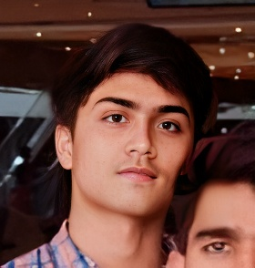


Enabling enhanced patient care aided by artificial Intelligence HealthAI Connect
TITLE
Major project
Abdul Rahman Hussain Siddique
(1604-20-737-084)
Syed Rahmath
(1604-20-737-095)
Omar Mohammed Khan (1604-20-737-113)
Under the guidance of :
Dr. MD Asrar Ahmed Sir ~Assistant Professor
Notes:
Welcome to the presentation on HealthAI Connect, an innovative platform at the forefront of healthcare transformation.

Slide 2
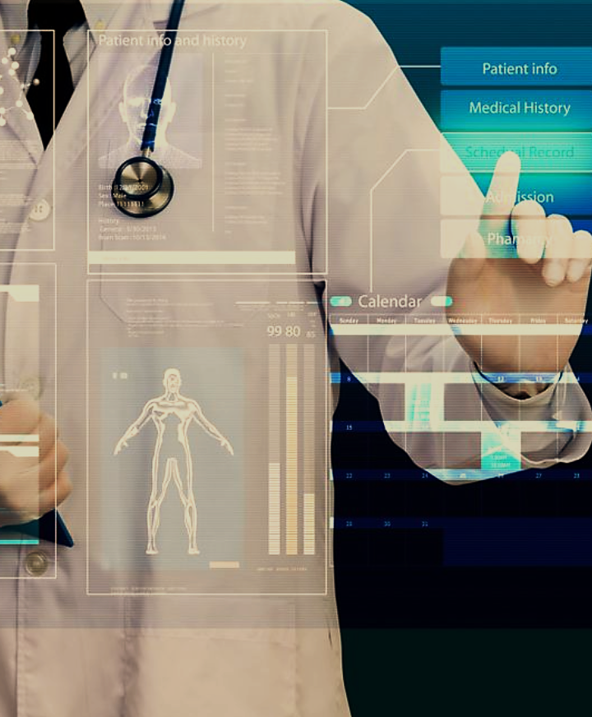
Abstract
Artificial Intelligence (AI) is revolutionizing healthcare, significantly enhancing patient care and diagnosis. Our project explores the vital role of AI and Machine Learning in healthcare through 'HealthAI Connect,' a platform that offers personalized patient guidance, predictive analytics, and improved healthcare accessibility.
Notes:
Artificial Intelligence is transforming healthcare, making patient care and diagnosis more effective than ever. Our project, HealthAI Connect, showcases how AI and Machine Learning can play a crucial role in healthcare. This platform provides personalized guidance for patients, utilizes predictive analytics, and improves access to healthcare services, making it easier for everyone to get the care they need.

Slide 3
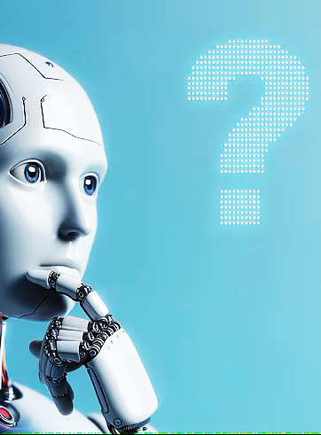
Problem statement
In the rapidly advancing technological era, there is a critical need for innovative solutions to enhance patient care, streamline diagnosis, and improve accessibility in healthcare. Traditional methods often fall short in providing rapid accessibility and timely detection of diseases.
Notes:
In today's fast-paced technological world, there's a pressing need for new solutions to improve patient care, make diagnoses more efficient, and enhance access to healthcare. Traditional methods often struggle to provide quick access and timely detection of diseases, highlighting the need for innovative approaches to meet these challenges.

Slide 4
Literature survey
PART 1
S.No | Title | Strategy | Advantage | Limitation
1. | "Human Disease Prediction based on Symptoms," 2023 | User symptoms + ML algorithms predict new, potentially fatal diseases. | Early detection, accessibility, adaptability. | Incomplete info, limited scope, no medical guidance.
2. | "Diseases Prediction based on Symptoms using Database and GUI" 2022 | Train ML with symptoms to predict diseases (Random Forest). | Convenient disease prediction based on user inputs. | Single algorithm, lacks comprehensive info (meds, precautions).
3. | "A Deep Language Model for Symptom Extraction From Clinical Text“ 2022 | Deep NLP extracts symptoms from clinical text. | Outperforms rivals in detail & clarity. | Single disease, no meds or precautions.
4. | "An Intelligent Disease Prediction and Drug Recommendation Prototype” 2023 | Use data mining for personalized drug recommendations in healthcare. | Enhances treatment outcomes with quick, tailored recommendations. | Relies on accurate data, potential biases.
5. | "Automating Information Retrieval from Faculty Guidelines: Designing a PDF-Driven Chatbot powered by OpenAI ChatGPT," 2023 | Use e-books for comprehensive education, offering searchability and link integration. | Enhances academic understanding with technical details and broader frameworks. | Time-intensive word embeddings creation
6. | "An AI-Based Medical Chatbot Model for Infectious Disease Prediction," 2022 | Utilize deep feedforward multilayer perceptron for medical chatbots in infectious disease prevention | Enhances interaction, provides accurate solutions. | It focuses only on infectious diseases, excluding all medical information.
Notes:
The table summarizes recent literature on disease prediction using machine learning and natural language processing techniques. ML algorithms can be applied to user symptoms or databases of medical information to predict disease. This allows for early detection and potentially more adaptable treatment plans. However, these systems are limited by the quality of the data they are trained on and may not provide comprehensive medical advice.

Slide 5
Literature survey
PART 2
S.No | Title | Strategy | Advantage | Limitation
7. | Dynamic NLP Enabled Chatbot for Rural Health Care in India | Uses Google dialog flow software for NLP | Multilingual NLP Models | Old technologies
8. | Interpretable Disease Prediction from Clinical Text by Leveraging Pattern Disentanglement | Feature Extraction (TFIDF) and Pattern Discovery and Disentanglement (PDD) | Collaboration with health care professional | Complexity of clinical language, Ethical and privacy concern
9. | Mobile Application for Doctor Appointment Scheduling | Medical appointments and consultations, Real-time Patient choice, live video appointment with a doctor | Adaptive web apps, accessible to every device | Complexity limits accessibility, Potential for misuse, only available to mobile users
10. | Detection of Pneumonia using Chest X-Ray Images and Convolutional Neural Network | Convolutional Neural Network, Chest X-Ray, Machine Learning, Detection | It gives HQ images even when using low quality input | Potential overfitting, Data quality and variability
11. | An Analysis of Image Segmentation Methods for Brain Tumour Detection | Image processing, MRI images, Brain Tumour, Image Segmentation | Improved accuracy | Less accuracy in tumour detection
12. | Disease prediction from various symptoms using machine learning | Disease prediction using machine learning algorithms like KNN Naïve bayes | Ensemble methods | Handling of multiclass classification.

Slide 6
Disadvantages of existing system
1
Limited Accessibility
2
Delayed Diagnosis
Existing systems struggle with geographical barriers, resulting in limited access to medical services.
Timely diagnosis is a challenge, leading to delays in providing accurate medical care to patients.
3
Inadequate Health Guidance
Patients struggle to find reliable,
understandable health information.
Notes:
Limited Access to Healthcare Professionals: Many patients face long wait times and limited access to healthcare providers, especially in rural or underserved areas.
Delayed Diagnosis and Treatment: Traditional healthcare methods often result in delayed diagnosis and treatment, particularly for critical conditions, due to reliance on periodic check-ups and manual assessments.
Inadequate Health Information and Guidance: Patients often struggle to find reliable and easily understandable health information, making it difficult to make informed decisions about their care.

Slide 7

Proposed Plan
Demand for Innovative Healthcare Solutions
Word embeddings, Vector databases, Open AI
AI integration
Machine Learning
DT, RF, NB, PAC, NLP, Computer Vision
Robust Communication
Appointment Booking System, Web Chat Services
Notes:
To address these disadvantages, we devised a plan with three key points in mind: utilizing AI technology, ML technology, and implementing a robust communication system.

Slide 8



Features
PART 1
Personalized Dashboards
Health Description based Disease Predictor
Symptoms based Disease Predictor
Dashboards offer patients appointment scheduling, health recommendations, and online consultations, while doctors get KPIs, task tracking, and a drug suggestions.
Enhances the predictive power by combining the strengths of NB and PAC, resulting in a more robust and accurate disease prediction model.
Harnessing the power of ensemble learning with RF and the interpretability of DT to improve accuracy and provide insights into feature importance

Slide 9
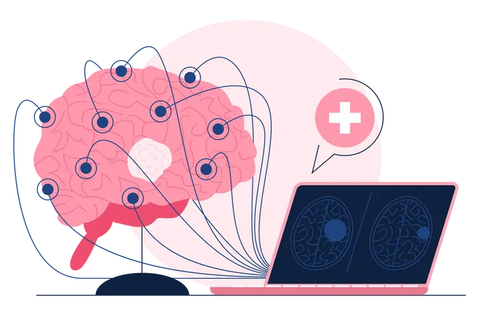
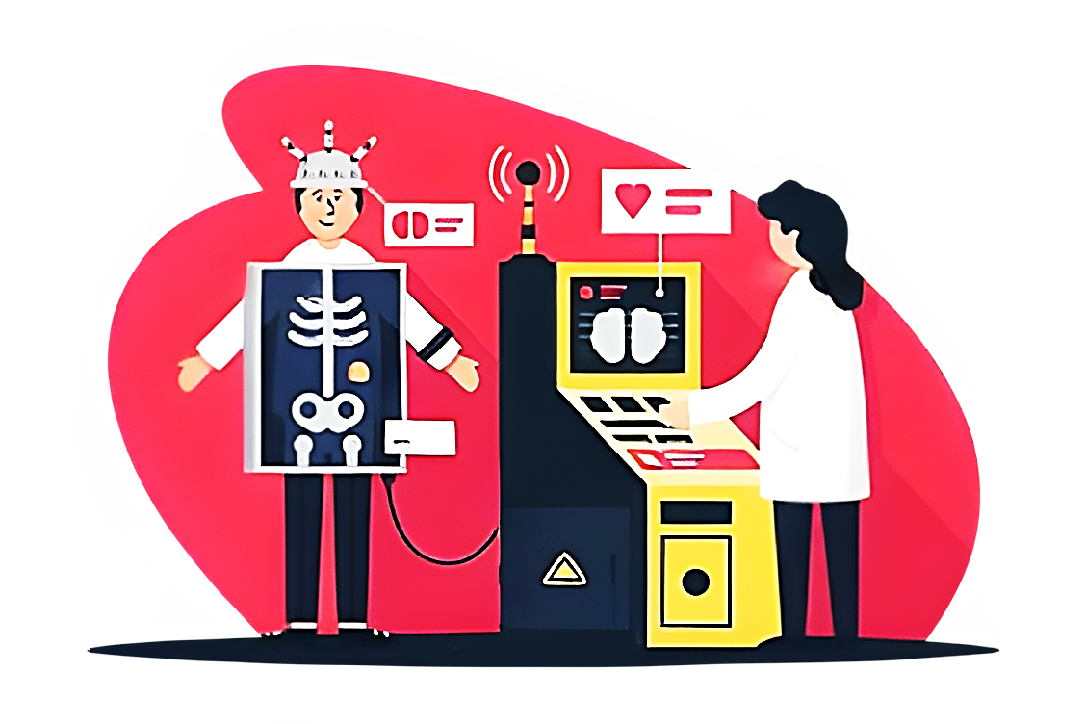

Features
PART 2
Brain Tumor Detection
Pneumonia Detection
NutriVision
Brain Tumor Detection uses transfer learning with CNN models to accurately identify brain tumors in MRI Scan images, enhancing early diagnosis and treatment.
Pneumonia Detection uses the VGG16 CNN model, pre-trained on ImageNet, to accurately predict pneumonia from chest X-ray images.
NutriVision uses the Gemini Pro Vision API to analyze food images and queries, providing detailed nutritional content and dietary insights.

Slide 10


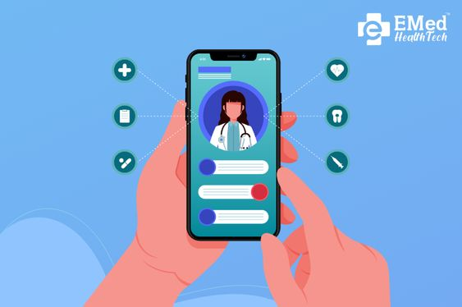
Features
PART 3
RAG Medical Chatbot
Appointment Booking System
Web Chat Consultation
Chatbot created using LangChain Framework, Hugging Face embeddings for enhanced comprehension, vector databases, OpenAI for coherent generation.
Incorporates secure login and separate dashboards for both patients and doctors. The appointment booking process for improved communication and accessibility.
Implements web sockets for real-time communication. Chats are securely stored in a SQL Lite database.

Slide 11
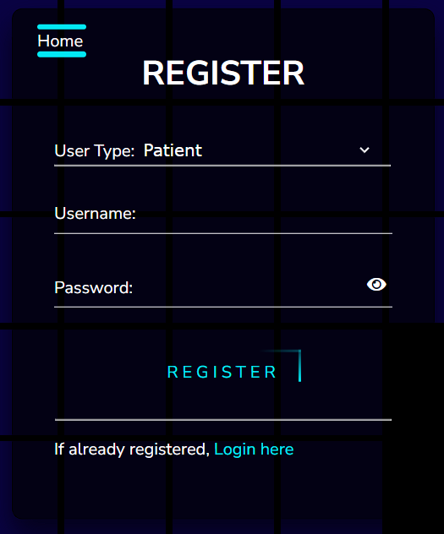
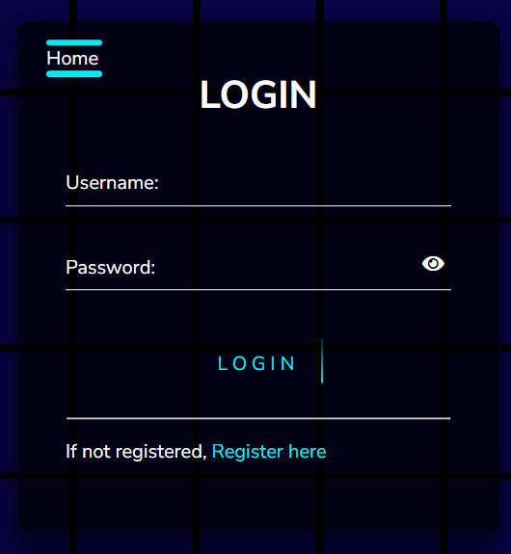
Register & Login
Notes:
These are registration and login pages. As the name suggests, users must register and select a user type, either as a patient or a doctor.

Slide 12
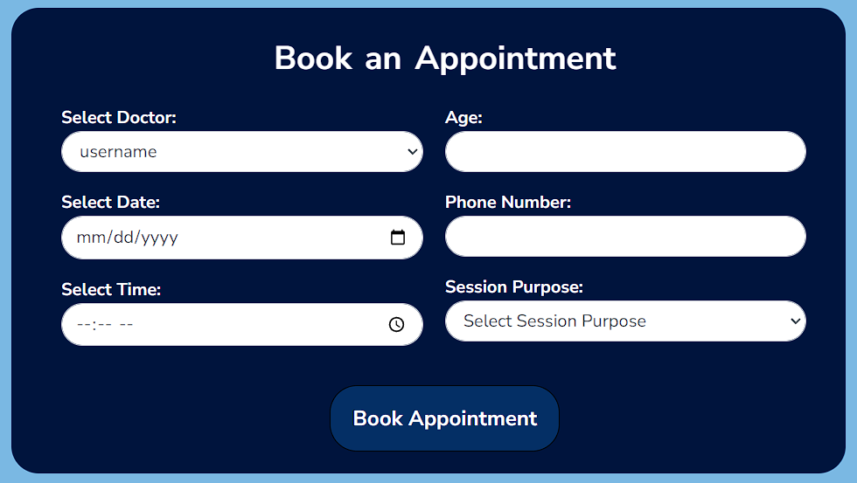
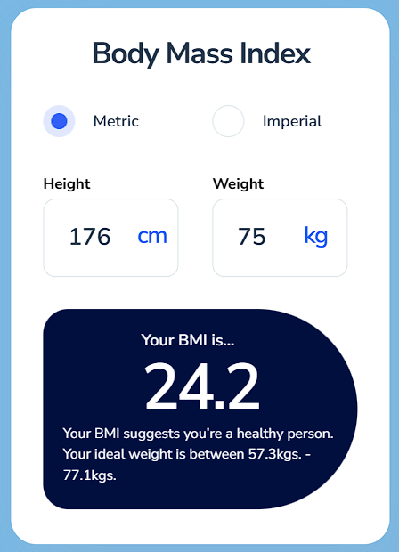
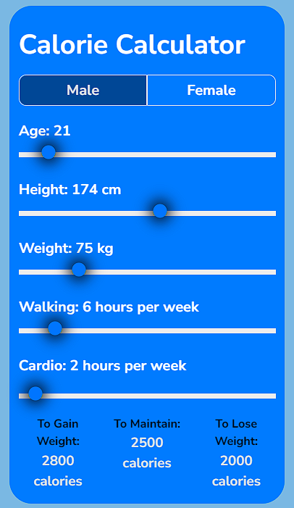
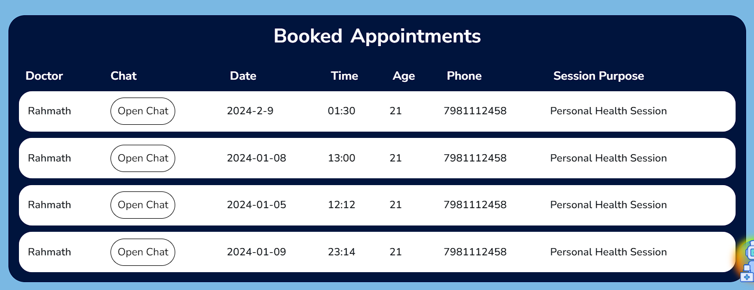
patient dashboard
BMI and Calorie Calculators
Notes:
After logging in, patients and doctors have personalized dashboards with different features.
Patients can use the BMI calculator to assess their physique.
To achieve or maintain a healthy physique, they can use the calorie calculator, which shows the appropriate amount of calories to consume.
Patients can also book appointments, which are updated in their booked appointments table once accepted by the doctor.

Slide 13
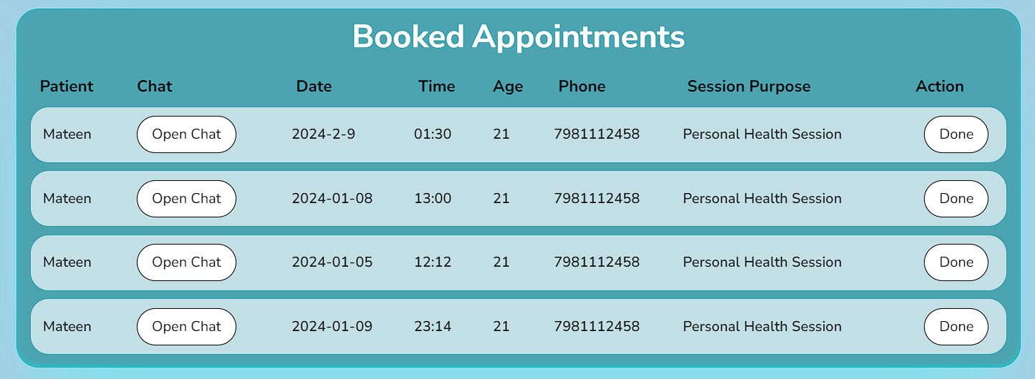
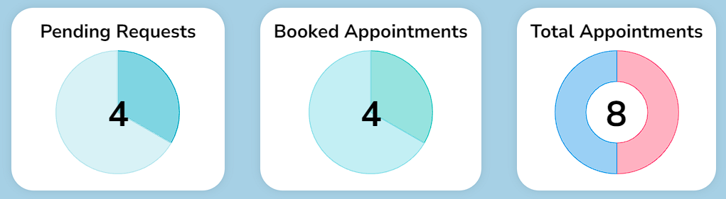
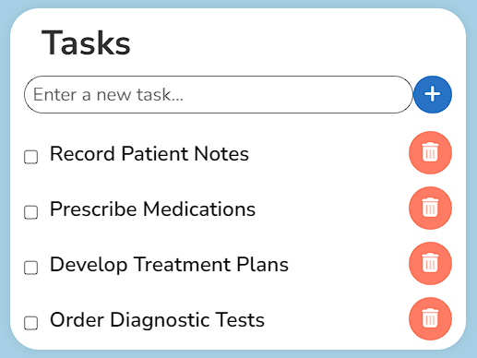
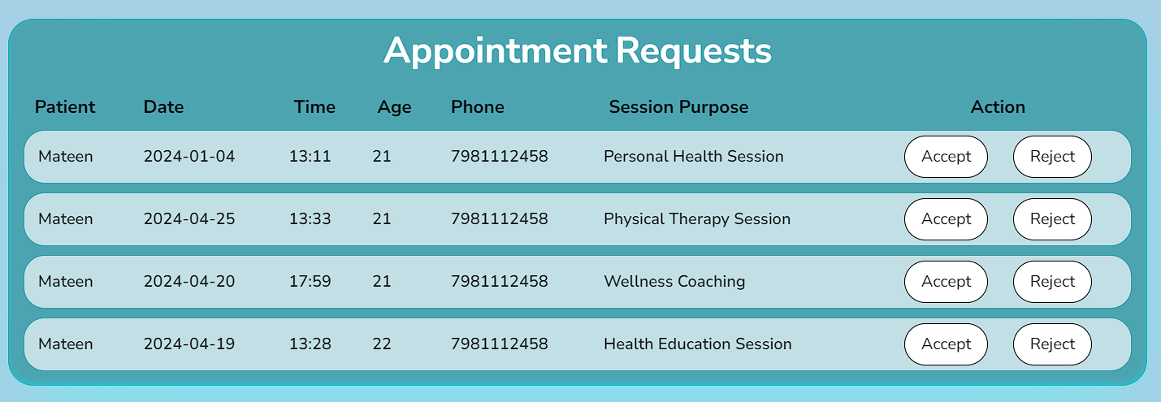
Doctor dashboard
KPIs, Tasks Lists, Appt System
Notes:
Here’s the doctor dashboard where the doctor gets key performance indicators, showing pending requests, booked appointments, and total appointments.
The doctor can use the task tracker to note down tasks.
They also receive appointment requests, which can be accepted or rejected accordingly.
If accepted, the appointment is updated in the booked appointments table.

Slide 14
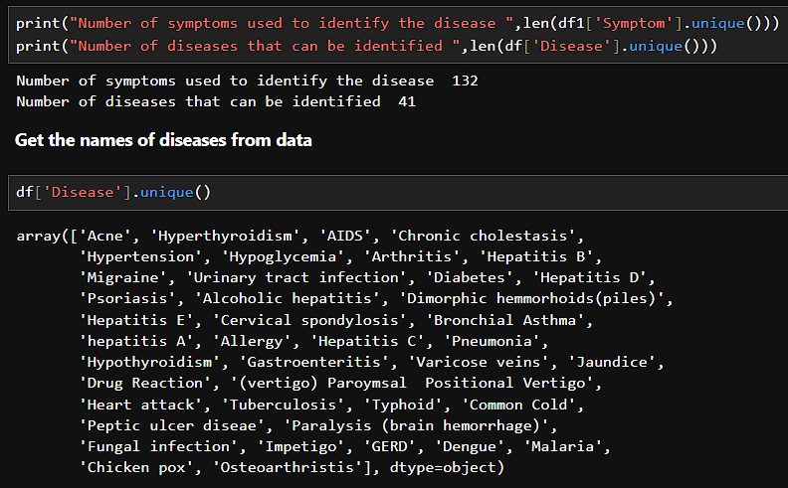
Symptoms Based Disease predictor
Data collection: Kaggle
Data Processing: EDA
Data Splitting: Training-80%, Testing-20%
Machine Learning Models:- Decision Tree & Random Forest
Notes:
We've developed a symptom-based disease predictor using data collected from Kaggle, encompassing 41 diseases and 132 unique symptoms.
During Exploratory Data Analysis, we addressed null values and optimized the data for model training.
The dataset was split into training and testing sets to assess model accuracies effectively.
We employed Decision Tree and Random Forest machine learning algorithms for prediction:
Decision Tree: Utilizes a tree-like structure to make predictions, where each branch represents a decision and each leaf represents an outcome.
Random Forest: An ensemble learning method that combines multiple decision trees to enhance accuracy and robustness by averaging their predictions.

Slide 15
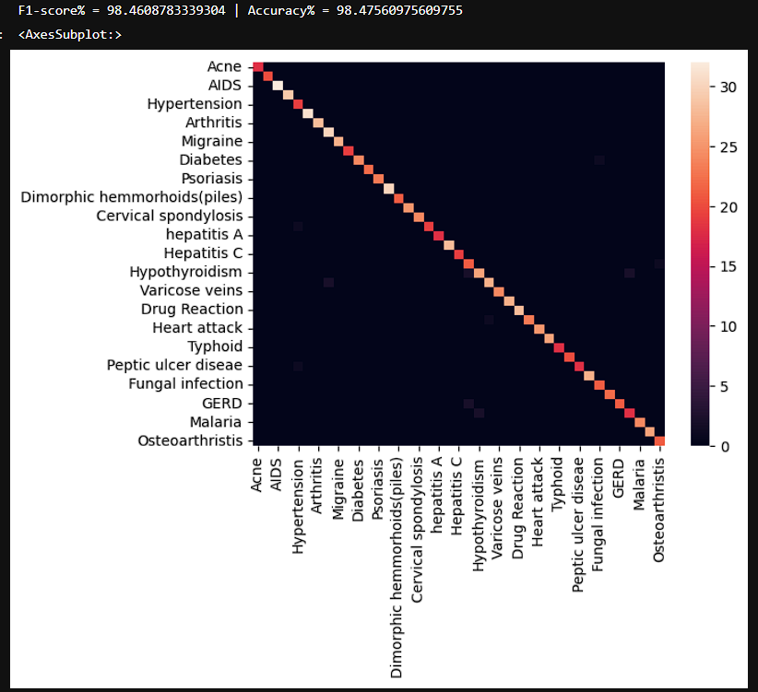
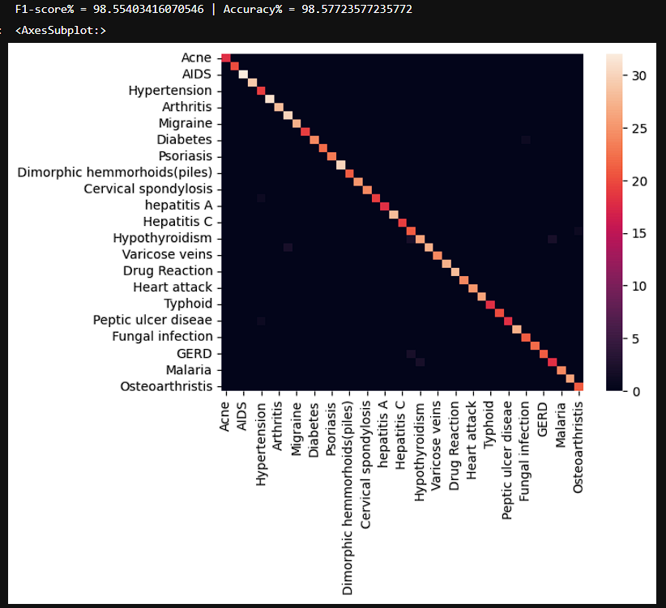
Accuracies and Heat Maps
Decision Tree
Random Forest
Notes:
The heat map shows the correlation between different diseases.

Slide 16
Output Screenshot of Symptoms Based Disease Predictor
1.Decision Tree 2. Random Forest
Notes:
Standard deviation: Indicates the model’s performance is consistently high with minimal variation.
This combination of high accuracy and low standard deviation suggests that the model is both effective and reliable

Slide 17
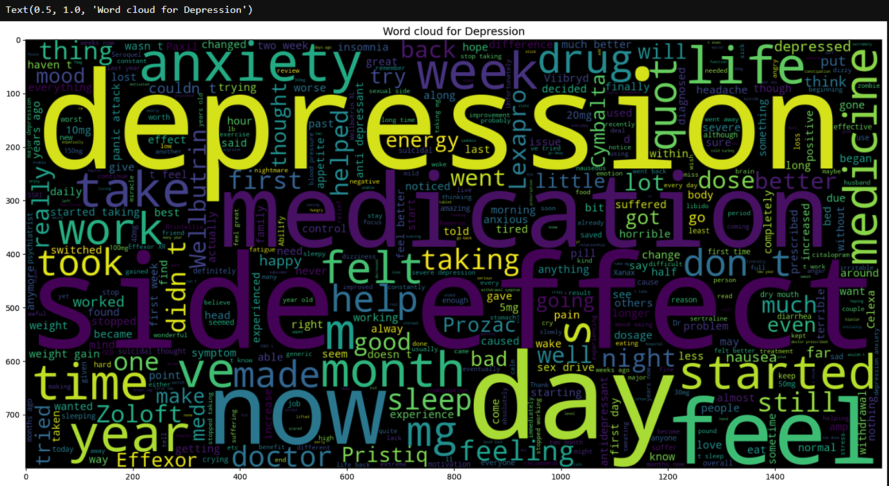
Description BASED DISEASE PREDICTOR
Data collection: UCI
Data Processing : EDA
Data Splitting : Train-80%, Test-20%
Machine Learning Models :
-Passive Aggressive Classifier
-Naïve Bayes
Word Cloud for Depression
Notes:
The data is collected from UCI machine learning repository, the dataset contains vast number of diseases but because of limited computing power we have selected only 8 diseases
And on that dataset we have conducted exploratory data analysis by eliminating stop words(such as in, and, or, are,...other conjunctions)
and executed lemmatization on the textual data, lemmatization involves reducing words to their base form(having, has, ,have = have)
Post lemmatization we crafted word cloud for each disease which highlights the most frequently occurring words by their size.
Following preprocessing the text undergoes vectorization in which sentences are transformed into numerical representation forming vectors which enables machine learning algorithms to process and analyse textual data effectively
After vectorization the data is split into training and testing subsets for evaluation of model performance
The machine learning models we have used are passive aggressive and naive bayes classifier which performs very well on textual data.
PAC - The passive-aggressive classifier is an online learning algorithm that adjusts its model parameters with each new instance to minimize classification errors, making it suitable for real-time applications.
NBC - The Naive Bayes classifier is a method used for categorizing text, determining the most likely category of a piece of text based on the probability of certain words appearing in that category, assuming each word's presence is independent of others.

Slide 18
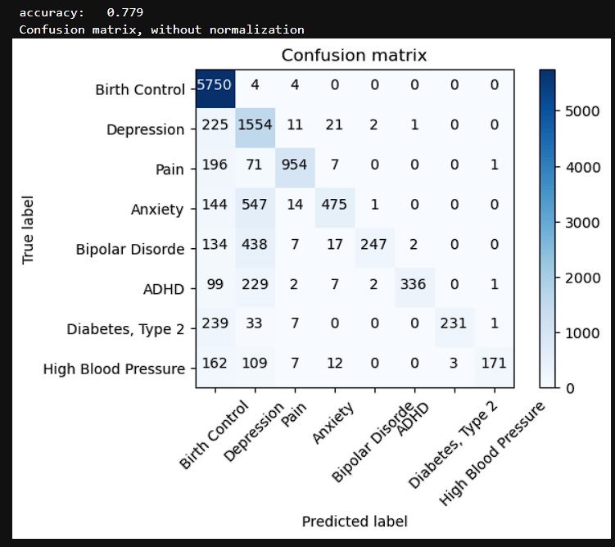
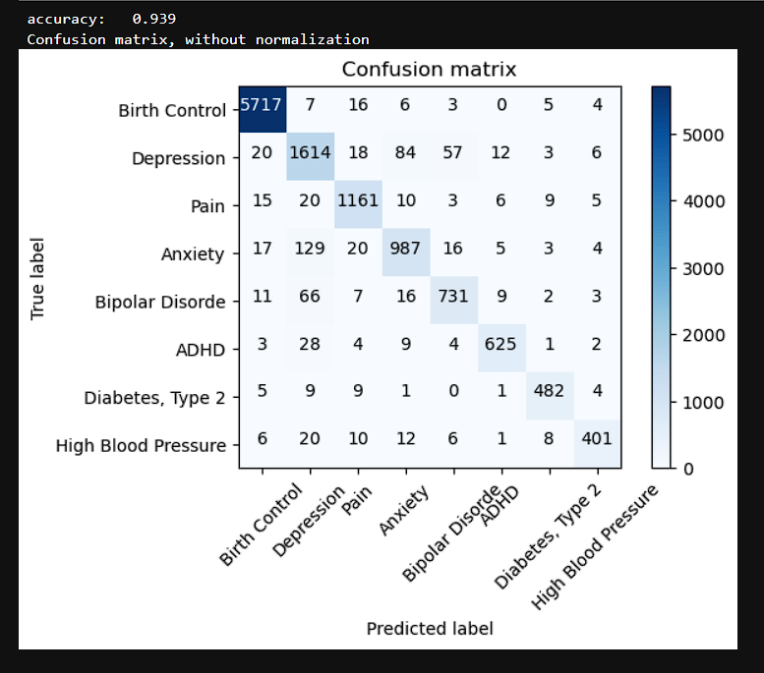
Accuracies and Confusion Matrix
Navie Bayes
Passive Aggressive Classifier
Notes:
This confusion matrix provides a detailed breakdown of the performance of a classification model across different classes.

Slide 19
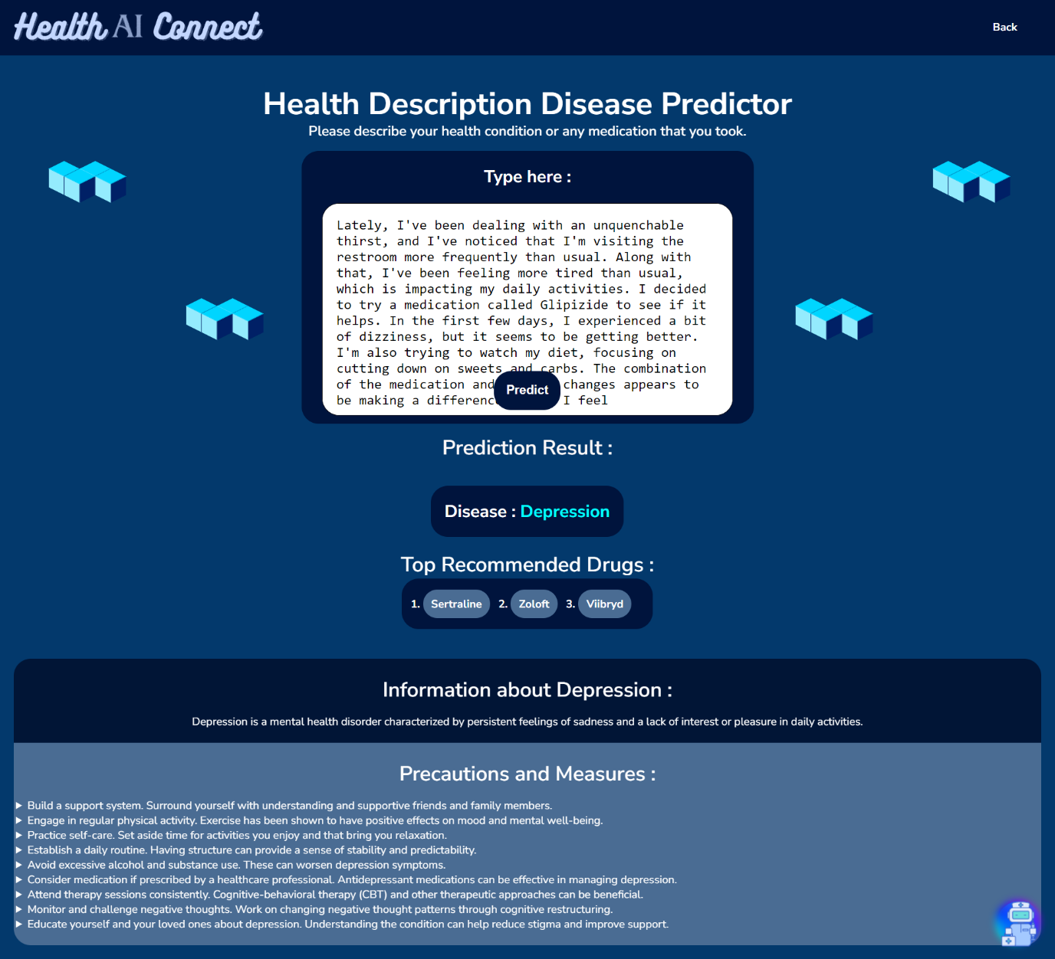
Output Screenshot of Description Based Disease Predictor

Slide 20
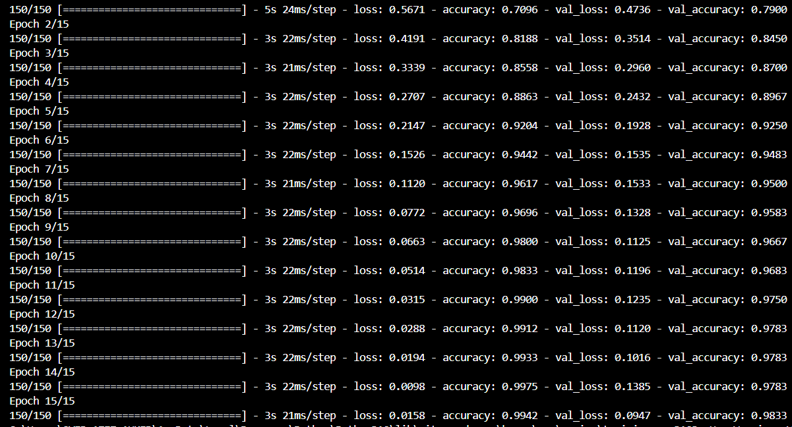
Brain tumor detection
Data collection: Kaggle, three folders: "yes," "no," and "pred," containing 3060 Brain MRI Images.
Data Processing: images resized to 64x64 pixels using PIL library
Model Building: CNN
Model Training: Model is fitted for 15 epochs (Batch size - 16)
Training Epochs
Notes:
The model architecture is constructed using the Sequential API from Keras. It consists of three convolutional layers followed by max-pooling layers to extract relevant features from the input images. Each convolutional layer is activated using the ReLU activation function to introduce non-linearity. The model then flattens the output from the convolutional layers and passes it through two fully connected dense layers. A dropout layer is added to mitigate overfitting, followed by a final softmax activation layer to output the predicted probabilities for each class.
For training the model, we compile it using the categorical cross-entropy loss function and the Adam optimizer. We then fit the model to the training data for 15 epochs with a batch size of 16.
The model achieves training accuracy of 99% and validation accuracy of 98%

Slide 21
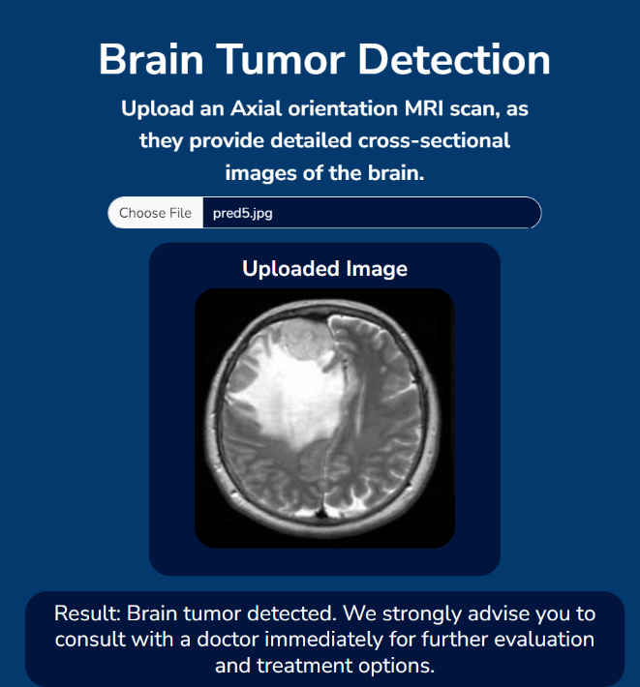
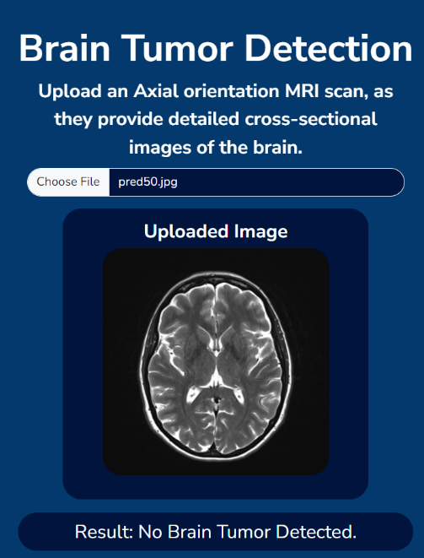
Tumor
No Tumor

Slide 22
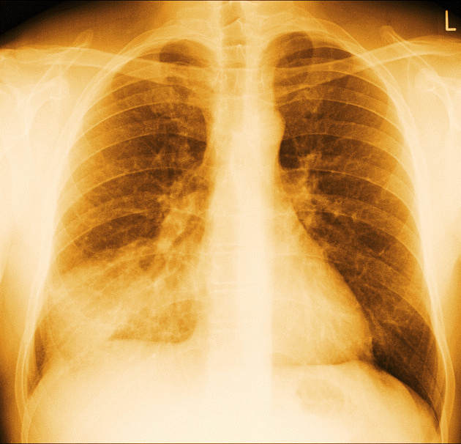
Pneumonia DETECTION
Data collection: Kaggle, 3 folders (train, test, val) containing 5,863 X-Ray images (JPEG) and 2 categories (Pneumonia/Normal)
Model Building: CNN (VGG16 Pretrained model)
Model Training: Model is fitted for 25 epochs
Notes:
The model architecture used for pneumonia detection is based on the VGG16 (Visual Geometry Group 16) convolutional neural network. VGG16 is a deep learning architecture that has been pre-trained on the ImageNet dataset, which contains millions of images across thousands of categories. By leveraging the pre-trained weights from VGG16, the model can effectively learn features from chest X-ray images and make accurate predictions regarding the presence of pneumonia.
The model achieves training accuracy of 98% and validation accuracy of 91%

Slide 23
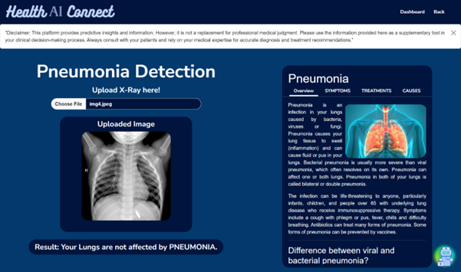
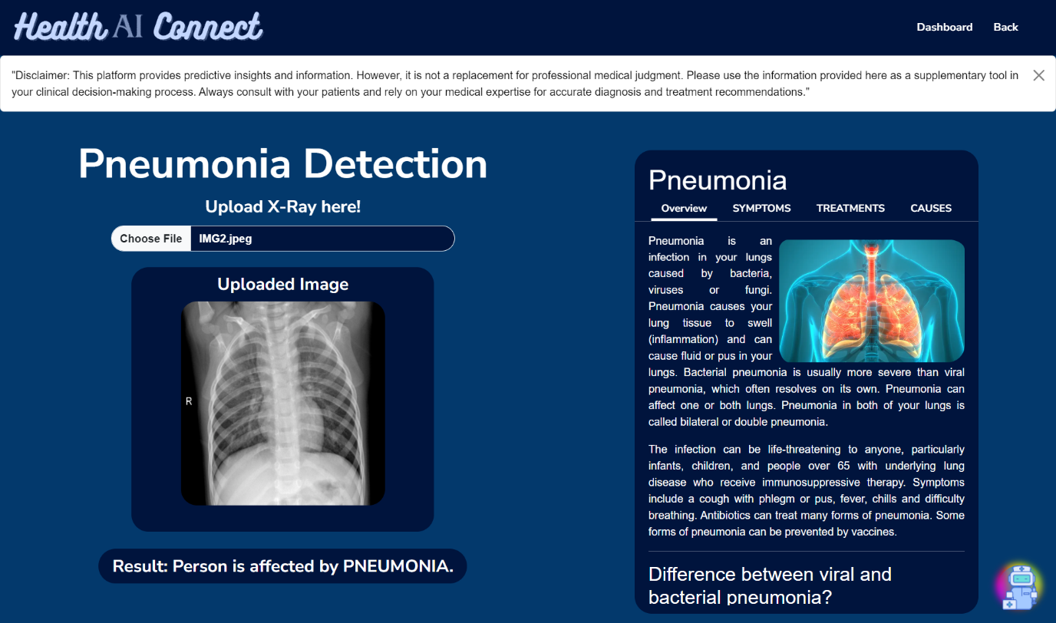
Normal
Pneumonia

Slide 24
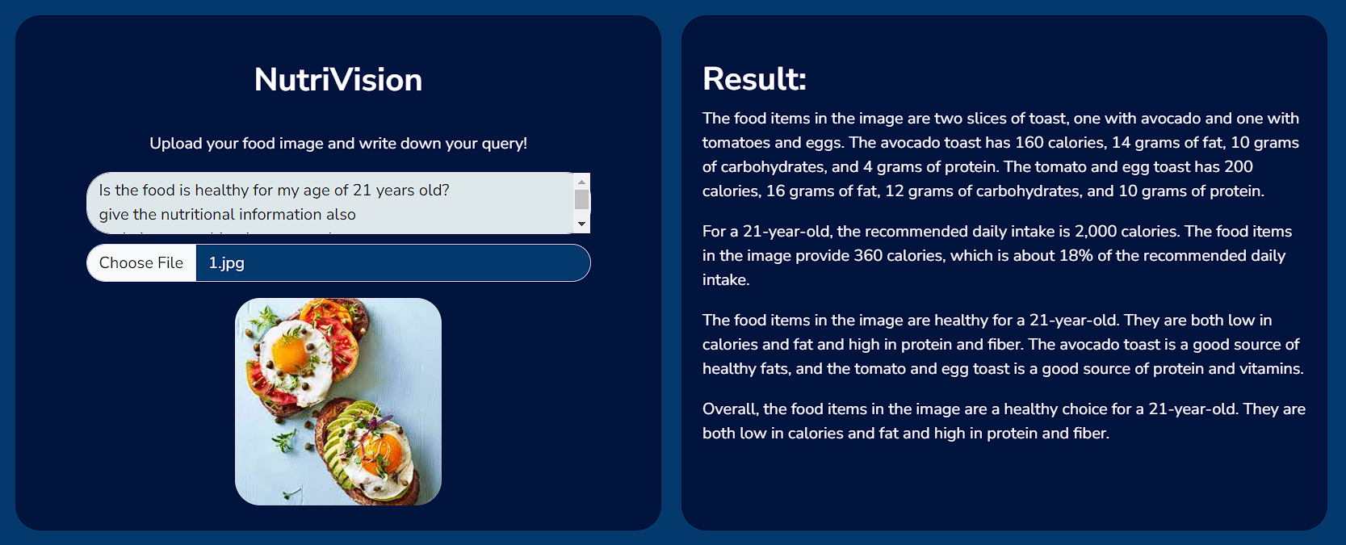
NutriVision
Notes:
Utilizing the powerful Gemini Pro Vision from Google, NutriVision seamlessly processes the image or query, extracting pertinent information regarding food nutrition and details

Slide 25
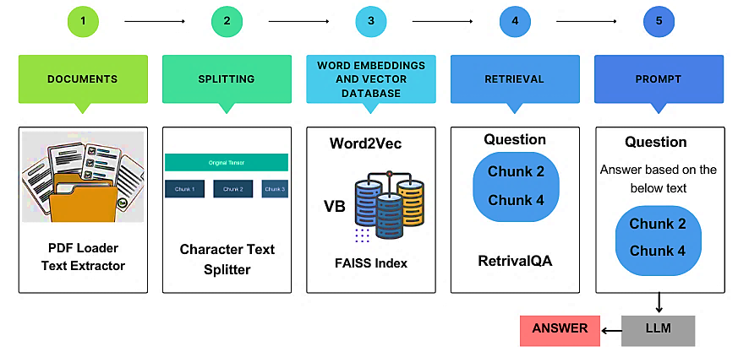
RAG Medical chatbot
Data collection: Medical textbooks from InfoBooks
Data Processing: Word Embeddings (Word2Vec) HuggingFace Model (Deepset_sentence_bert)
Notes:
This is our (Retrieval augmented generation ) RAG medical chatbot aka medibot.
For its knowledge base we compiled several medical textbooks from the website infobooks.
It was developed using langchain framework which helps in building application powered by LLMs
Process is as follows:
1. User Initiates Chat and Asks a Medical Question:
The user interacts with the chatbot, posing a question related to their health. This question could be about symptoms, diseases, medications, or general health information.
2. User Query Preprocessing:
LangChain preprocesses the user's query using NLP techniques. This might involve:
Tokenization: Breaking the query down into individual words or phrases (tokens).
Normalization: Lowercasing words, removing punctuation, and stemming (reducing words to their root form).
3. Word Embeddings and Retrieval:
Word Embedding Generation: LangChain utilizes pre-trained word embedding models (e.g., Word2Vec, GloVe) to convert each token in the query into a numerical vector. These vectors capture the semantic meaning and relationships between words.
Medical Knowledge Base Search: The chatbot utilizes LangChain to search a medical knowledge base (documents) for relevant articles or information. This search leverages the user's query vector and compares it to the vectors representing documents in the knowledge base. Documents with the highest similarity scores are retrieved.
4. Retrieval Augmented Generation (RAG):
Retrieval Stage:From the retrieved documents, LangChain selects the top "k" most relevant ones based on their similarity scores. These documents likely contain factual medical information related to the user's query.
Generation Stage:LangChain utilizes a pre-trained language model (e.g., GPT-3, BART) to formulate a human-readable response that addresses the user's question.

Slide 26
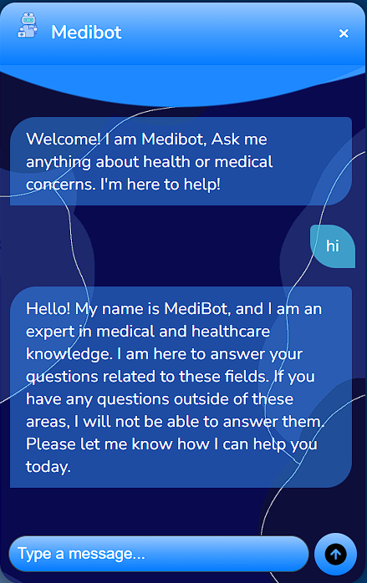
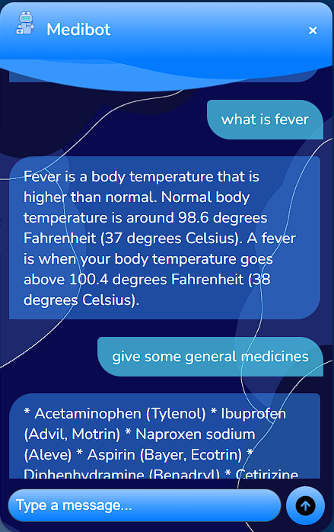
Chatbot output’s
Notes:
Conclusion : chudi udhi

Slide 27
Four picture collage
References
U. K. Kommineni, D. P. P. Kowthavarapu, G. S. M. Polukonda and K. C. Yelavarti, "Human Disease Prediction based on Symptoms," 2023 7th International Conference on Computing Methodologies and Communication (ICCMC), Erode, India, 2023, pp. 677-682, doi: 10.1109/ICCMC56507.2023.10083702.
K. S. Kumar, M. Sai Sathya, A. Nadeem and S. Rajesh, "Diseases Prediction based on Symptoms using Database and GUI," 2022 6th International Conference on Computing Methodologies and Communication (ICCMC), Erode, India, 2022, pp. 1353-1357, doi: 10.1109/ICCMC53470.2022.9753707.
X. Luo, P. Gandhi, S. Storey and K. Huang, "A Deep Language Model for Symptom Extraction From Clinical Text and its Application to Extract COVID-19 Symptoms From Social Media," in IEEE Journal of Biomedical and Health Informatics, vol. 26, no. 4, pp. 1737-1748, April 2022, doi: 10.1109/JBHI.2021.3123192.
S. K. Nayak, M. Garanayak, S. K. Swain, S. K. Panda and D. Godavarthi, "An Intelligent Disease Prediction and Drug Recommendation Prototype by Using Multiple Approaches of Machine Learning Algorithms," in IEEE Access, vol. 11, pp. 99304-99318, 2023, doi: 10.1109/ACCESS.2023.3314332.
M. A. Khadija, A. Aziz and W. Nurharjadmo, "Automating Information Retrieval from Faculty Guidelines: Designing a PDF-Driven Chatbot powered by OpenAI ChatGPT," 2023 International Conference on Computer, Control, Informatics and its Applications (IC3INA), Bandung, Indonesia, 2023, pp. 394-399, doi: 10.1109/IC3INA60834.2023.10285808.
S. Chakraborty, Sanjay and Paul, Hrithik and Ghatak, Sayani and Pandey, Saroj Kumar and Kumar, Ankit and Singh, Kamred Udham and Shah, Mohd Asif et al., "An AI-Based Medical Chatbot Model for Infectious Disease Prediction," in IEEE Access, vol. 10, pp. 128469-128483, 2022, doi: 10.1109/ACCESS.2022.3227208.

Slide 28
Four picture collage
References
A. S, N. R. Rajalakshmi, V. P. P and J. L, "Dynamic NLP Enabled Chatbot for Rural Health Care in India," 2022 Second International Conference on Computer Science, Engineering and Applications (ICCSEA), Gunupur, India, 2022, pp. 1-6, doi: 10.1109/ICCSEA54677.2022.9936389.
M. Ehghaghi, P. -Y. Zhou, W. Y. Cheng, S. Rajabi, C. -H. Kuo and E. -S. A. Lee, "Interpretable Disease Prediction from Clinical Text by Leveraging Pattern Disentanglement," 2023 IEEE EMBS International Conference on Biomedical and Health Informatics (BHI), Pittsburgh, PA, USA, 2023, pp. 1-7, doi: 10.1109/BHI58575.2023.10313408.
S. Usharani, S. Prithivi, S. Sharmila, P. M. Bala, T. Ananth Kumar and R. Rajmohan, "Mobile Application for Doctor Appointment Scheduling," 2021 International Conference on System, Computation, Automation and Networking (ICSCAN), Puducherry, India, 2021, pp. 1-6, doi: 10.1109/ICSCAN53069.2021.9526398.
T. Nag, S. S. Rajawat and A. Rana, "Detection of Pneumonia using Chest X-Ray Images and Convolutional Neural Network," 2021 9th International Conference on Reliability, Infocom Technologies and Optimization (Trends and Future Directions) (ICRITO), Noida, India, 2021, pp. 1-4, doi: 10.1109/ICRITO51393.2021.9596172.
N. M. Dipu, S. A. Shohan and K. M. A. Salam, "Deep Learning Based Brain Tumor Detection and Classification," 2021 International Conference on Intelligent Technologies (CONIT), Hubli, India, 2021, pp. 1-6, doi: 10.1109/CONIT51480.2021.9498384.
A. Goswami and M. Dixit, "An Analysis of Image Segmentation Methods for Brain Tumour Detection on MRI Images," 2020 IEEE 9th International Conference on Communication Systems and Network Technologies (CSNT), Gwalior, India, 2020, pp. 318-322, doi: 10.1109/CSNT48778.2020.9115791.

Slide 29
THANK YOU
HEALTHAI CONNECT

